Slide 1
Milking the Data
An analysis using NYC Subway data around the New York Marathon
By Scott Turransky

Slide 2
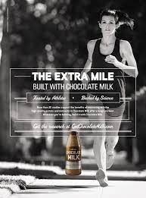
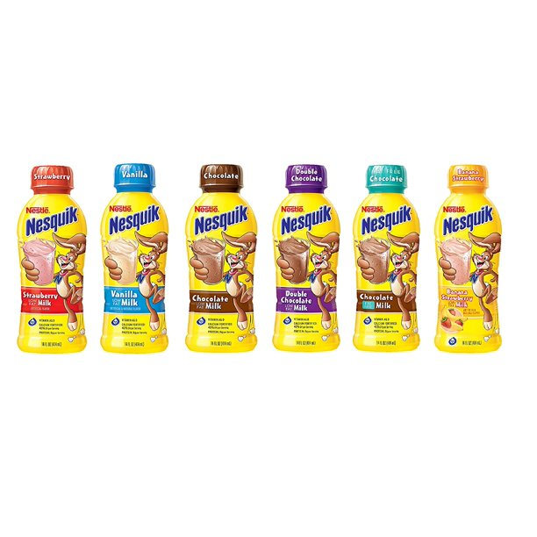
Introduction
Studies have indicated that chocolate milk is one of the best recovery fuels after an athletic event.
Nesquik wants to advertise its milk flavor variety “More than Chocolate” to New York Marathon runners after the race
The goal is to find the train station that gains the most runners after the race so Nesquik can set up a popup station to give away samples.

Slide 3
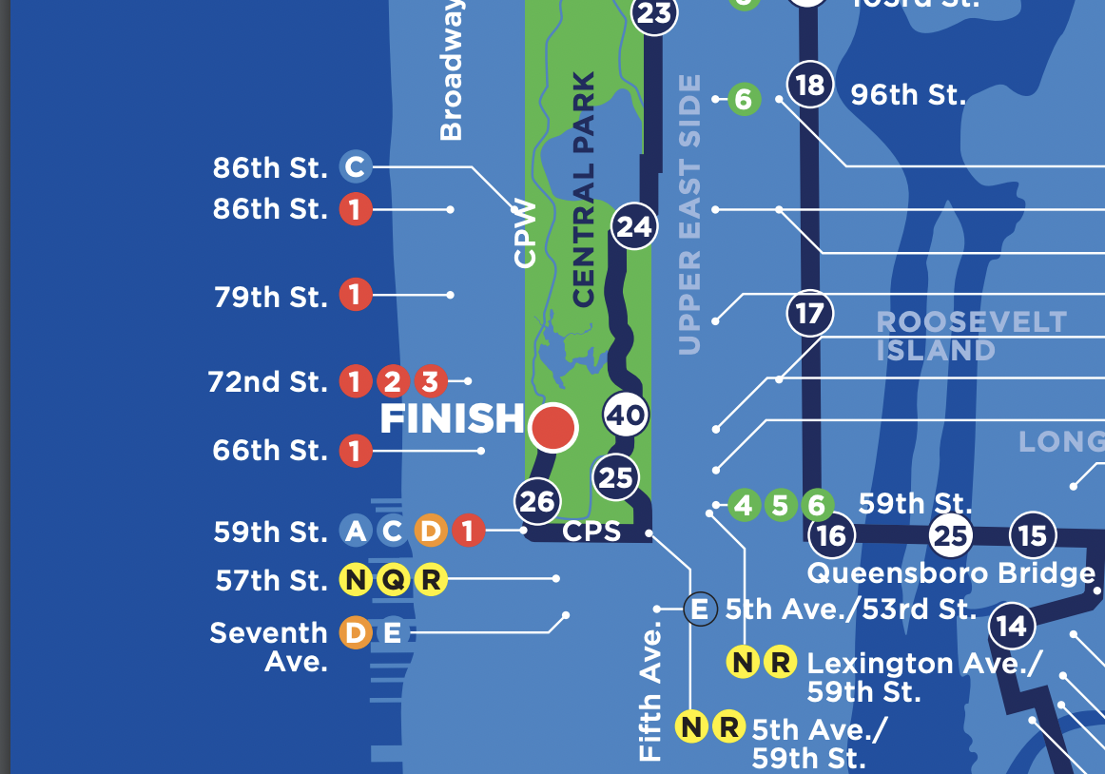
Methodology
Using the race course information online, identify stations to assess (10 near finish line, 1 far from course for control)
Use actual New York subway (MTA) data for marathon dates and the 2 Sundays before and after for comparison.

Slide 4
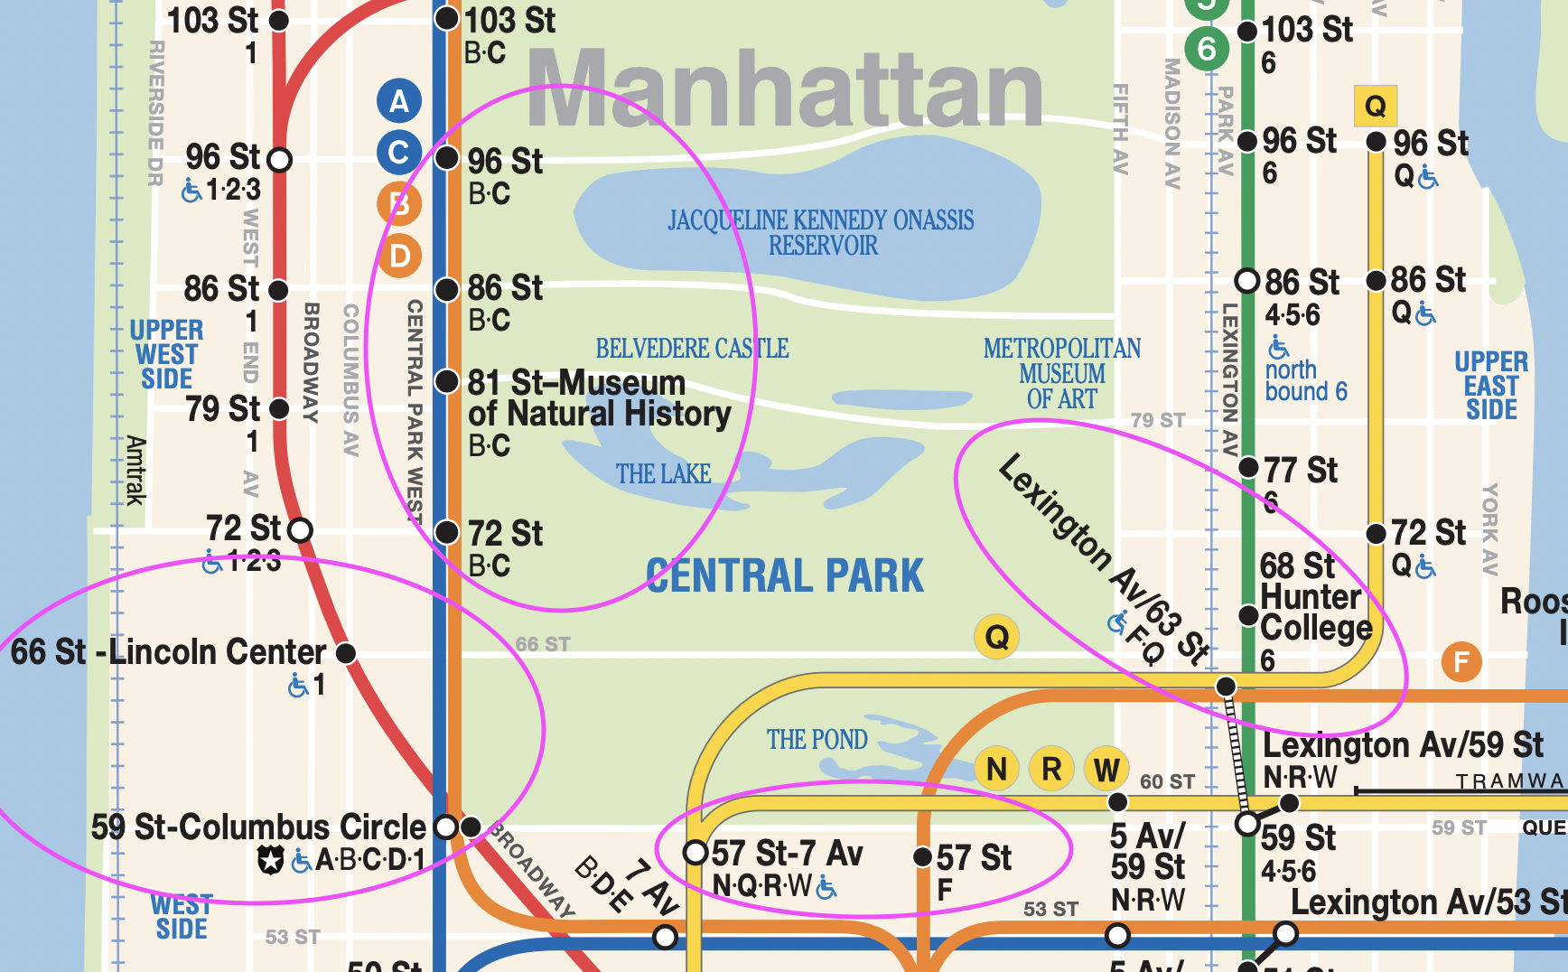
Methodology

Slide 5
Issues addressed
Stations with similar or identical names
Daylight savings time affecting reading hours
Variance in station entries from year to year

Slide 6
Tools used
SQL and SQLAlchemy to import to Python
Python, Numpy and Pandas for database management
Matplotlib and Seaborn for visuals

Slide 7
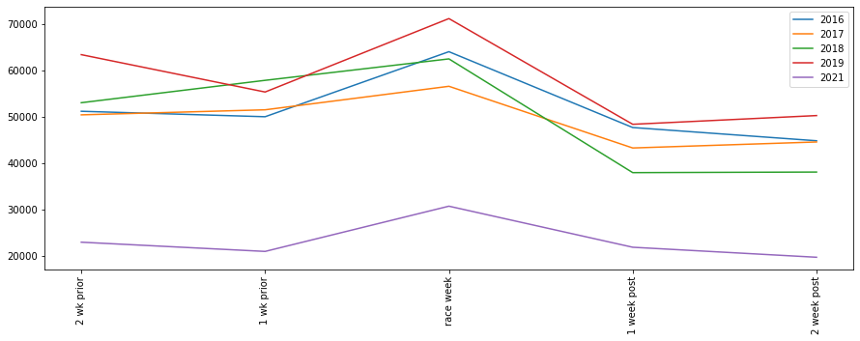
Dates used for assessment
There is a clear spike on race day at these stations. Th next step is to identify the best station for the Nesquik booth.

Slide 8
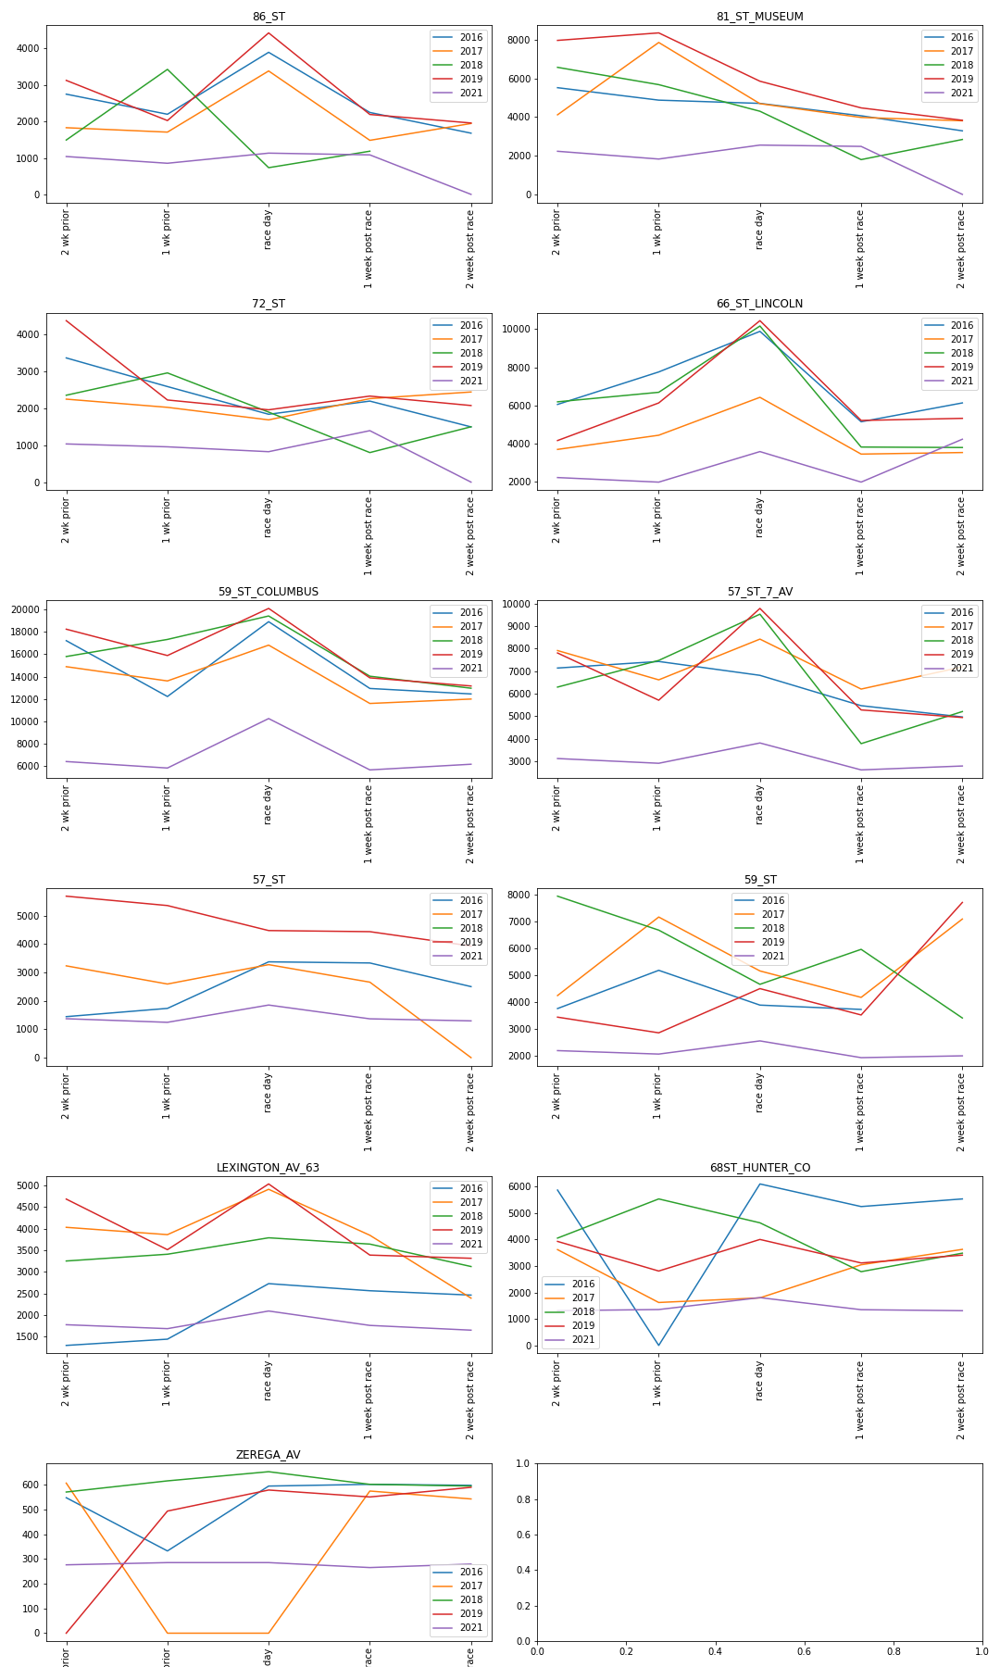


Plots for individual stations

Slide 9
Plots for individual stations

Slide 10
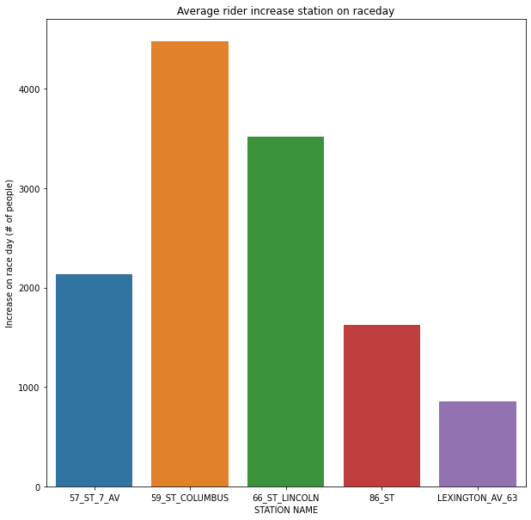
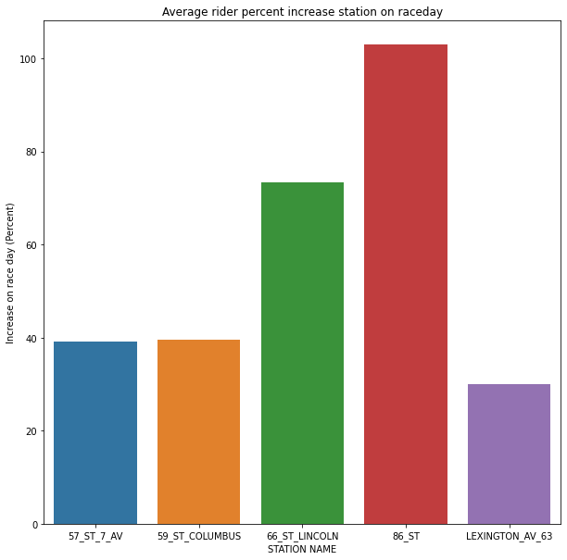
Final Results
66 St Lincoln was determined to be the optimal station due to a high percentage increase and a high increase in number of entries.

Slide 11
Final Results
Station | Race Day Average Increase* | Percent Increase
57 ST 7 AV | 2133 | 39.1%
59 ST COLUMBUS | 4476 | 39.5%
68 ST LINCOLN | 3515 | 73.3%
86 ST | 1621 | 102.94%
LEXINGTON AV 63 | 858 | 30.0%
66 St Lincoln was determined to be the optimal station due to a high average annual increase in number of entries. Since it had a higher % increase than 59 ST Columbus the people at that station were more likely to be runners, rather than average Sunday traffic.
*5 year average increase in station entries compared to that year’s average entries on adjacent Sundays

Slide 12
Any questions?

